Slide 1


Private Pension Plan
Case 3 A – Group 3
Financial Engineering

Slide 2
Presentation Roadmap
Tentative
1
Client Profile
Retirement Income Gap
Time Value Advantage
German State Pension Analysis
Investment Requirements Analysis
Asset Allocation Detail
Investment Implementation
Stress Testing
2
3
4
5
6
7
8

Slide 3




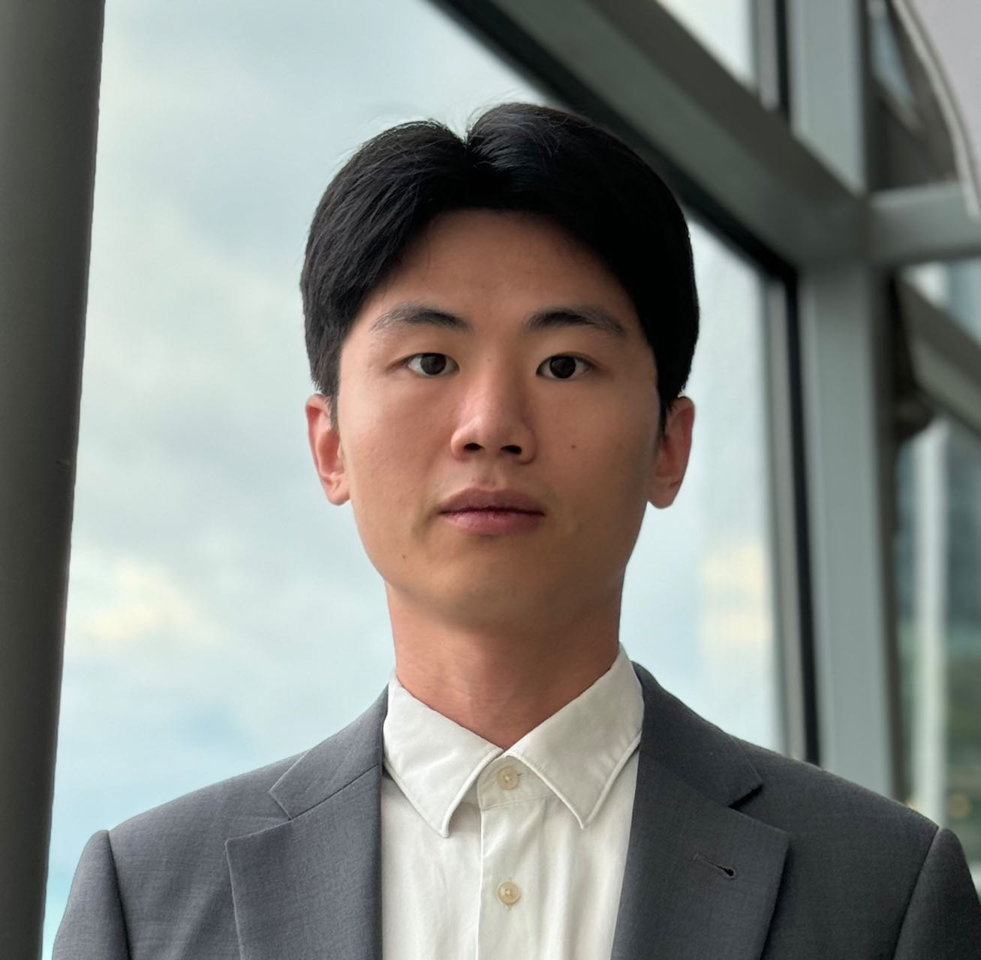
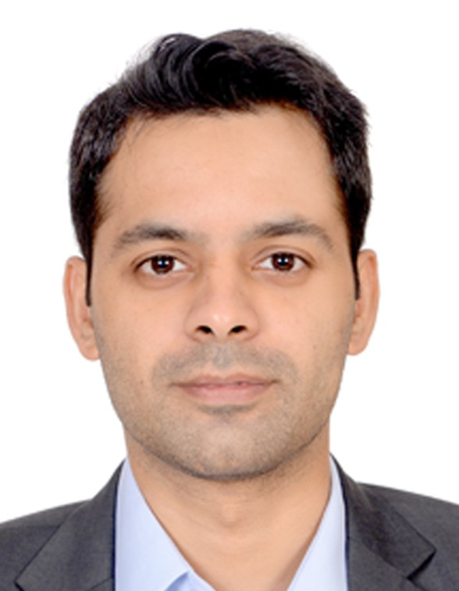

Team
Ying Liu
8513629
Abdul Malik
8512905
Marco Leibersperger
8518121
Ritesh Kumar
8510249
Shangrun Jiang
8501084
Mujtaba Ali Bhutto
8513611
Chang Liu
8514049

Slide 4
Thank you !

